Slide 1

Toward phylodynamic inference from Typewriter lineage recordings
Antoine Zwaans & Sophie Seidel
03/04/2023
Sophie Seidel
30 June 2021, ISMB/ECCB
Notes:
Hello & thank you for joining
Present a framework to estimate
-> use single cell lineage tracing & rna seq data
→ to infer
1

Slide 2
Outline
Model validation
Runtime

Slide 3

Clock rate – editing speed

Slide 4
Insert probabilities – which insertion

Slide 5
Validation results
Clock rate (Cov=97%)
Insert probabilities (Cov=95%)

Slide 6
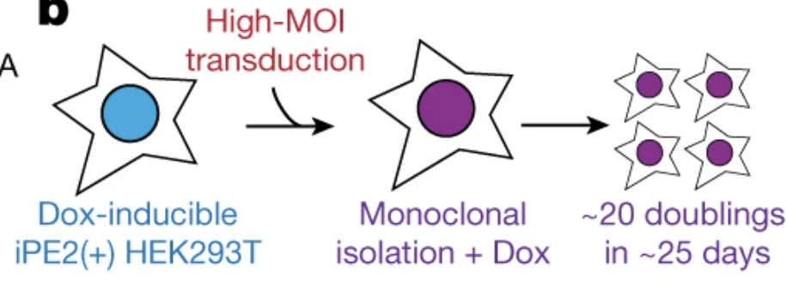
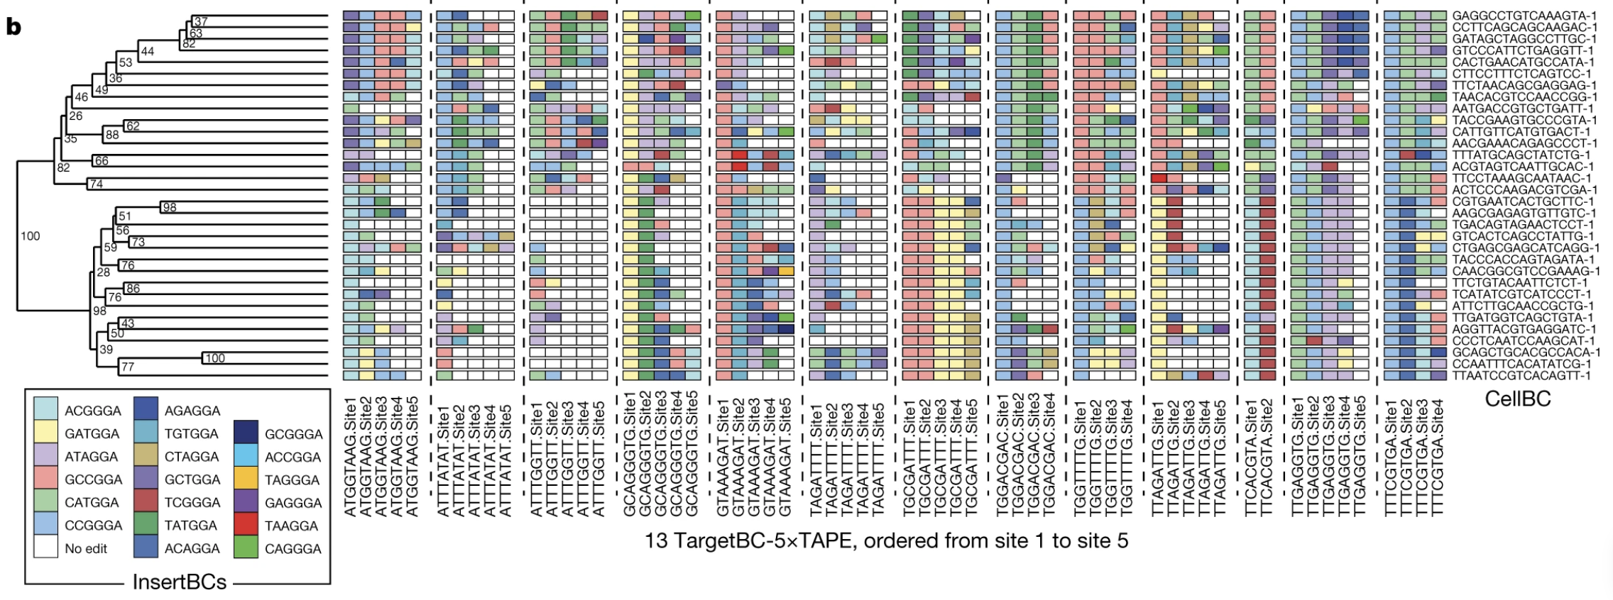
Analysis of the HEK data

Slide 7
Analysis of the HEK data

Slide 8
Analysis of the HEK data

Slide 9
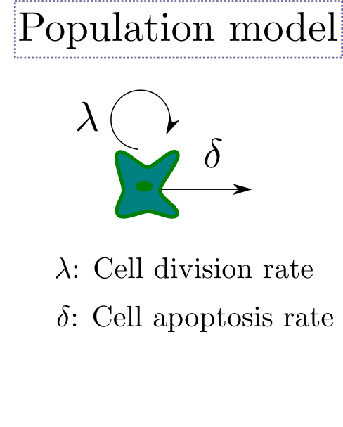
Analysis of the HEK data

Slide 10
Analysis of the HEK data

Slide 11
Thinking about tree space MAP vs UPGMA

Slide 12
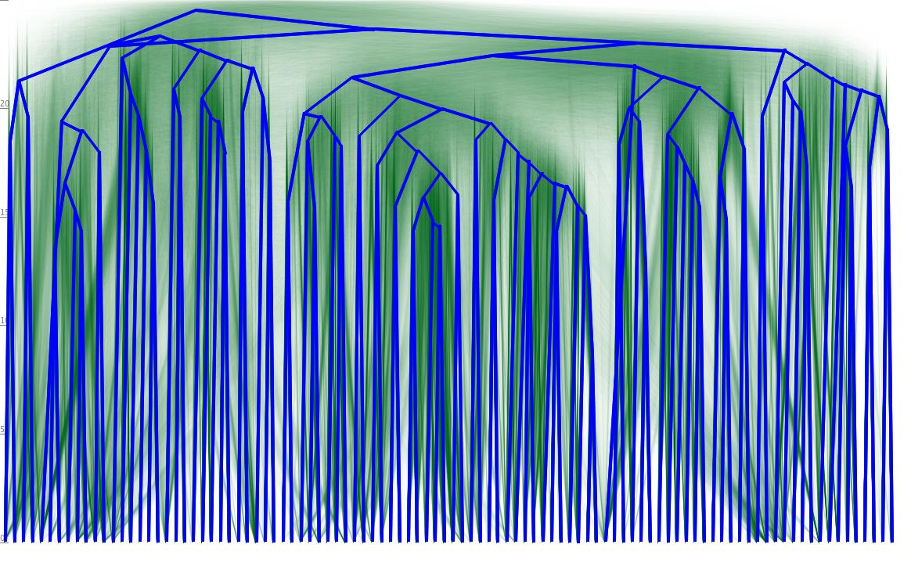
Thinking about tree space – Tree posterior

Slide 13
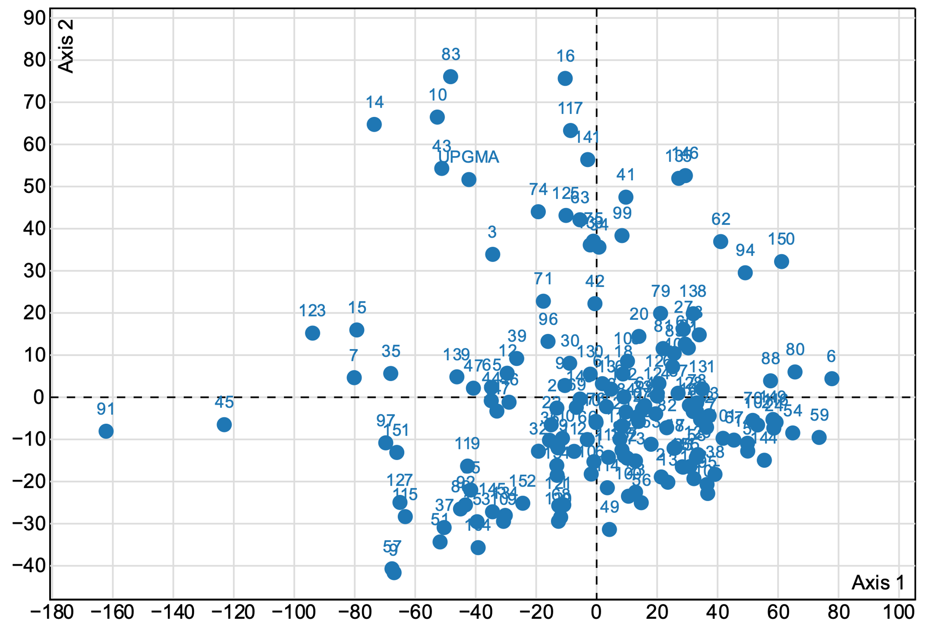
Thinking about tree space

Slide 14
Questions / Discussion

